Slide 1
SOM Research Lab
Jordi Cabot
@softmodeling – jordicabot.com November 2019

Slide 2
+
=
Notes:
They do the work, I take care of the marketing

Slide 3
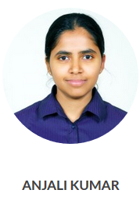
Notes:
They do the work, I take care of the marketing

Slide 4
Our mission
We are interested in the broad area of systems and software engineering, especially promoting the rigorous use of models and engineering principles while keeping an eye on the most unpredictable element in any project: the people.
Create Better Software Faster
Flickr/clement127
Notes:
Similar to many of you

Slide 5
Better Software Faster
Core MDE
Artificial Intelligence
Open Source + Open Data

Slide 6
Featured Lines
Notes:
Before we talk about the relationship between modeling and AI, we should make sure we have a common understanding of these concepts

Slide 7
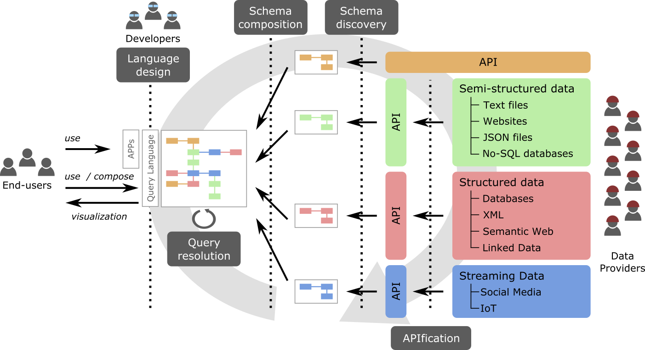
Open Data for All – National Research Project

Slide 8
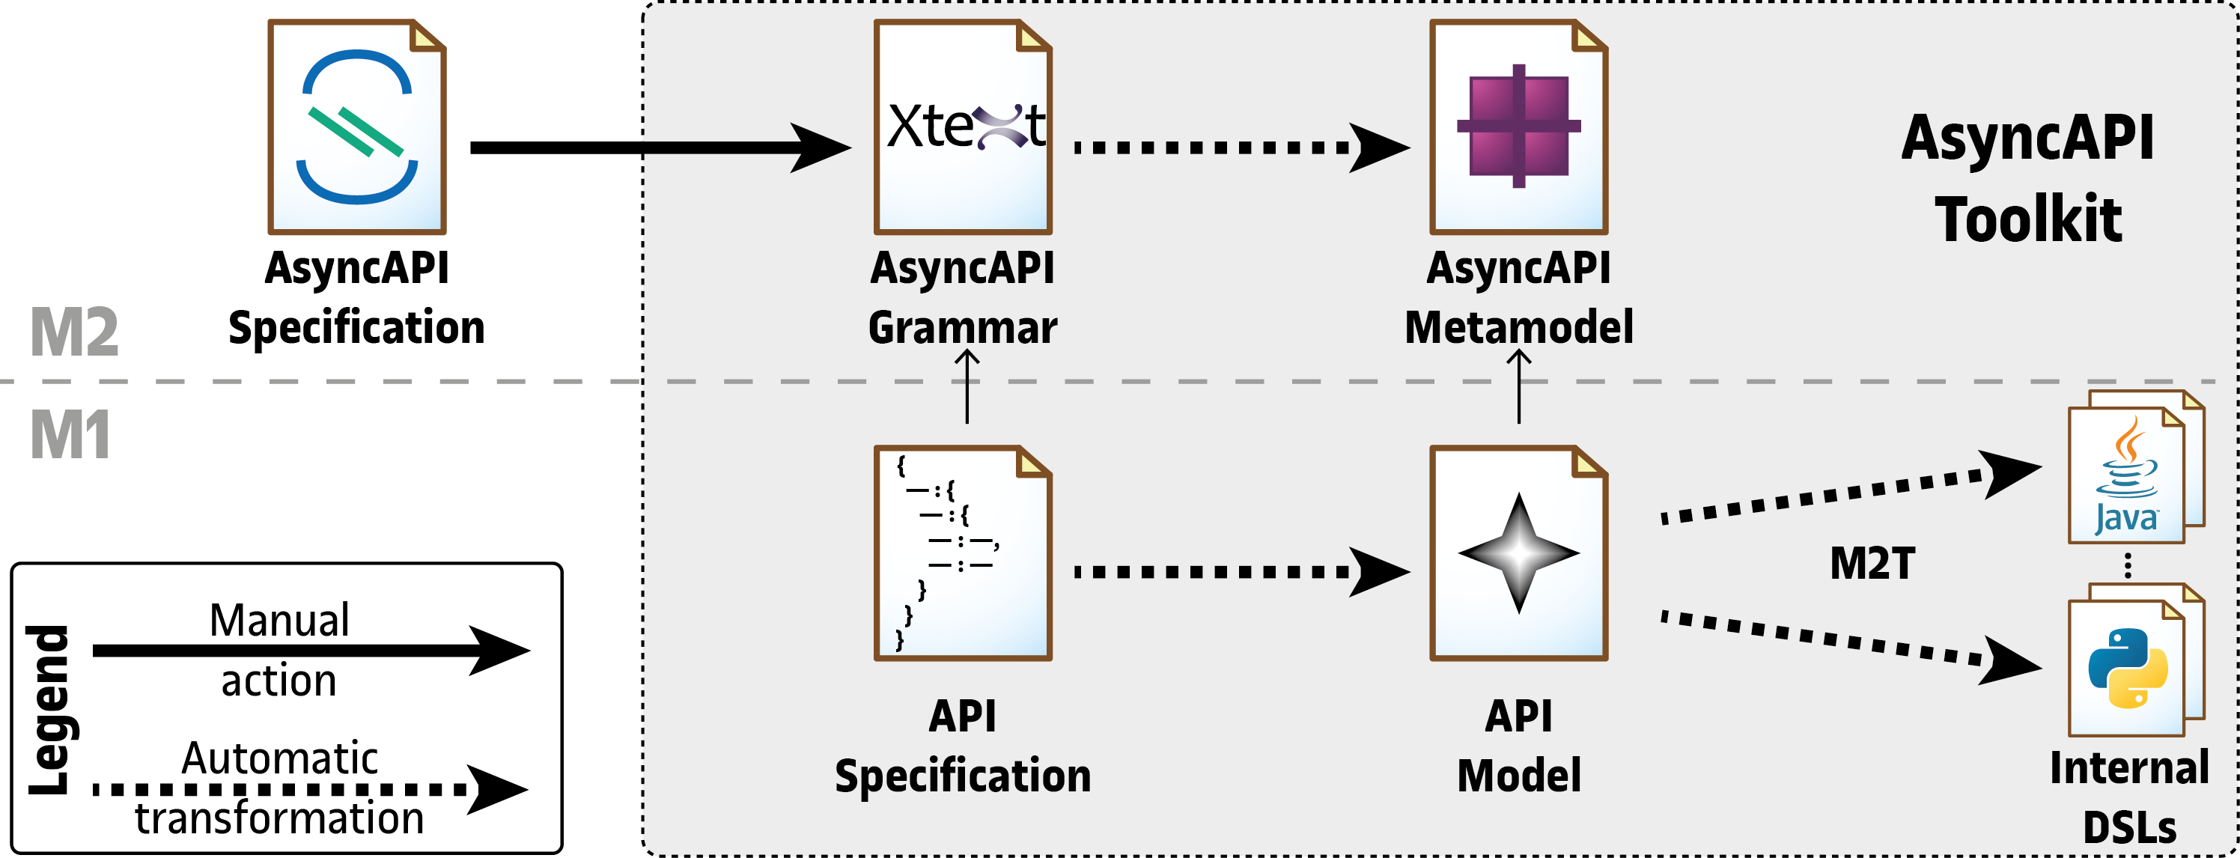
All kinds of APIs

Slide 9
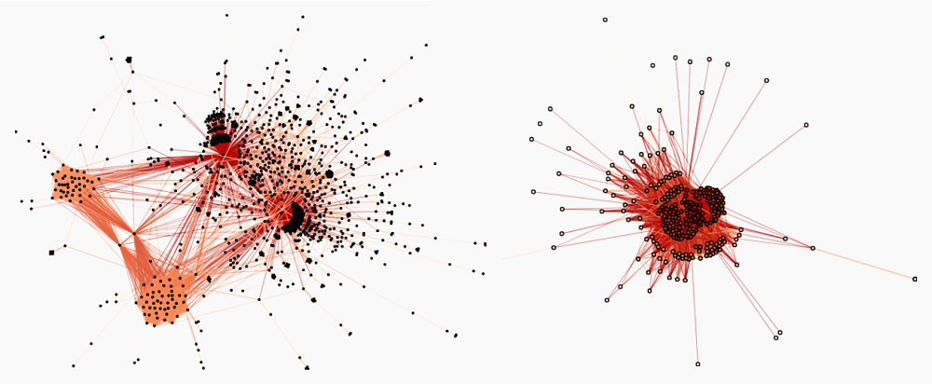
Organization of open source communities: rich-club, nestedness, modularity….

Slide 10
Graph Kernels

Slide 11
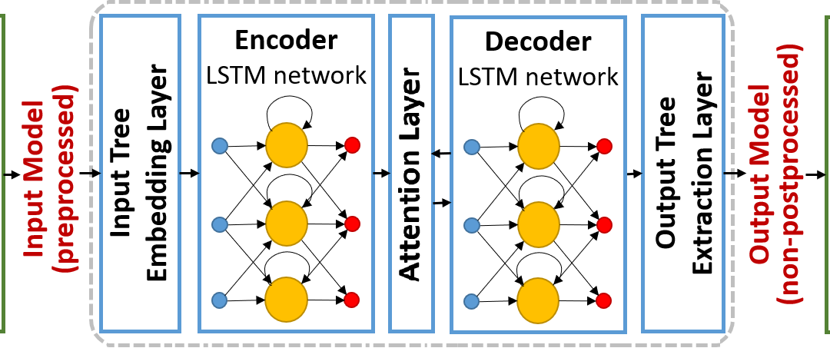
Replacing Model Transformations with Neural Networks

Slide 12
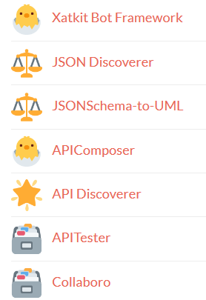
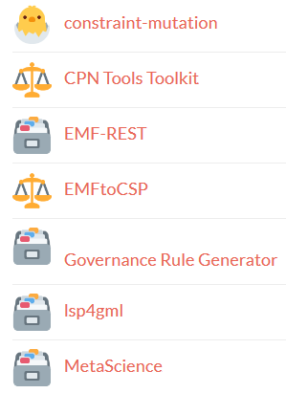
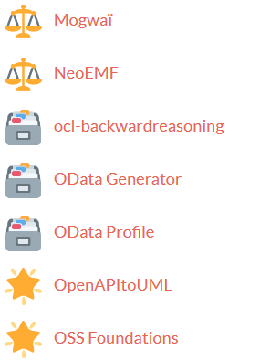
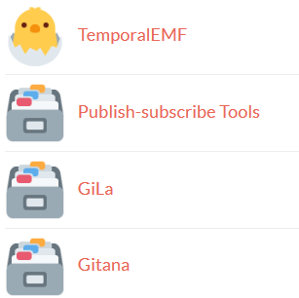
Going beyond papers (DON’T do this at home)

Slide 13
Xatkit – A spin-off applying MDE to the world of (chat)bots
https://xatkit.com/
Notes:
Before we talk about the relationship between modeling and AI, we should make sure we have a common understanding of these concepts

Slide 14
Chatbots are complex systems
Plus a huge ecosystem of incompatible low-level development tools
Text Processing
Deployment
Evolution
Conversation Logic
Maintenance
Tests
Messaging Platforms
External Services

Slide 15
Xatkit Framework
Raise the level of abstraction at what chatbots are defined
Focus on the core logic of the chatbot
Conversation and user interactions
Action computations
Independent from specific implementation technologies
Automatize the deployment and execution of the modeled chatbot
Deploy over multiple platforms
Execute the chatbot logic
MDE
COMPATIBLE

Slide 16
Xatkit Framework
Intent Recognition Providers
(platform-specific)
Platform-independent
chatbot definition
Instant
Messaging
Platforms
Chatbot
Designer
Xatkit Modeling Language
Xatkit Runtime
Intent Package
Chatbot
User
uses
Execution Package
Platform
Designer
External
Services
uses
Platorm Package
Deployment
Configuration

Slide 17
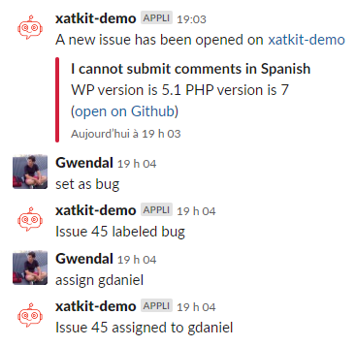
Example: Saving maintainers’ time – Chatbot for reporting errors

Slide 18
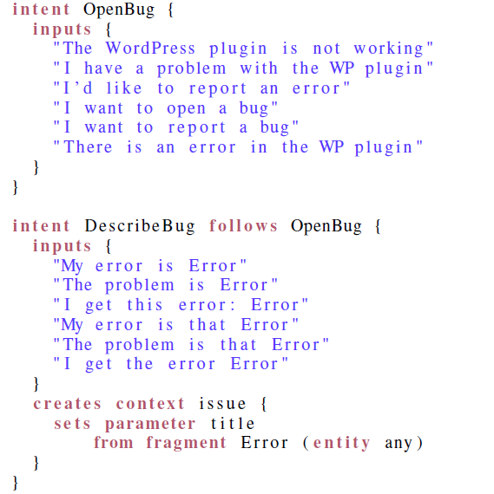
We collect all the info we need.
We can define a partial order, collect parameters, define enumerations, …

Slide 19
